Slide 1

PREDICTING CUSTOMER BUYING BEHAVIOUR

Slide 2
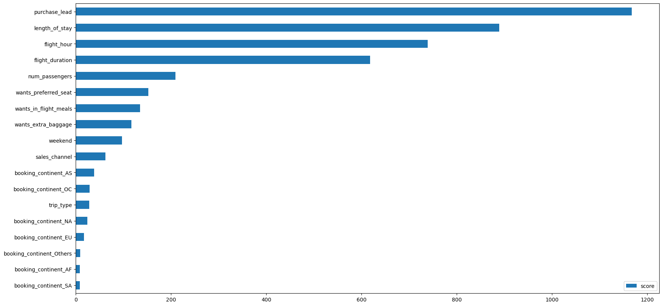
Predictive model to understand customer buying behavior
The top 3 features that influence Customer buying behavior are:
Purchase lead
Length of stay
Flight hour/duration
It was found that the unfinished booking process has a higher average purchase_lead value than the completed booking process.
The average value of length_of_stay from bookings that are not completed is higher than bookings that are completed

